Slide 1
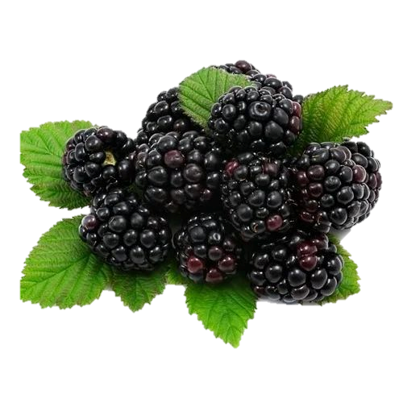


FRUIT NAME
Fruit is good for health. Fruit is good for health.
Fruit is good for health.
Fruit is good for health.
Fruit is good for health.
Fruit is good for health.
Fruit is good for health.

Slide 2
FRUIT NAME
Fruit is good for health. Fruit is good for health.
Fruit is good for health.
Fruit is good for health.
Fruit is good for health.
Fruit is good for health.
Fruit is good for health.

Slide 3
FRUIT NAME
Fruit is good for health. Fruit is good for health.
Fruit is good for health.
Fruit is good for health.
Fruit is good for health.
Fruit is good for health.
Fruit is good for health.

